Slide 1
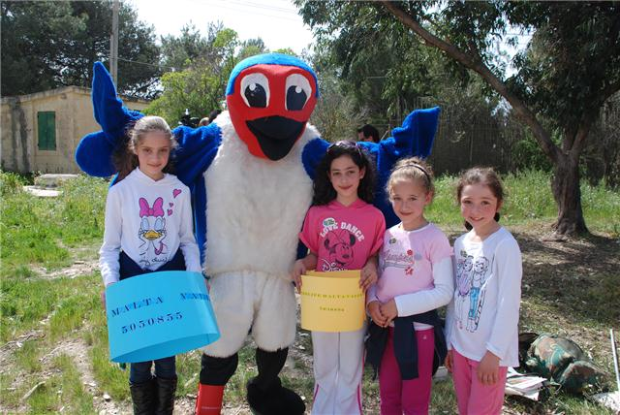
Children’s Marathon Fundraising Walk Sunday, 24 March 2013
Children from Klabb Ħuttaf and Dinja Waħda choosing coloured ‘rings’ to put on Ħuttaf, the mascot of Klabb Ħuttaf, after learning about scientific bird ringing at Is-Simar Nature Reserve at the end of the fundraising marathon walk for nature

Slide 2
Today 178 children and adults from Malta walked 10 kilometres through the Maltese countryside to raise money and awareness for nature conservation. Starting in Rabat, the children walked all the way to Is-Simar Nature Reserve in Xemxija, raising a total of €1545 Euros.
The ‘Walk for nature’ is an annual event organized by Klabb Ħuttaf, BirdLife Malta’s nature club for young people, and is one of the activities for school children participating in BirdLife’s Dinja Waħda environmental education programme for primary schools run by Birdlife and Bank of Valletta. Bank of Valetta staff joined the children on the walk.
This year the money raised will be used to pay for solar panels to power lights at the Comino Bird Ringing Station, BirdLife Malta’s centre for scientific ringing studies on the island Bird Sanctuary and Nature Reserve of Comino, where BirdLife carries out regular scientific ringing of migrating birds as they pass through the Maltese Islands on their journey between Africa and Europe every spring and autumn.

Slide 3
After arriving at Xemxija the children took part in a demonstration of scientific bird ringing in front of the Nature Reserve: A lucky few were invited to practise their ringing skills on Ħuttafa, the human-sized European Barn Swallow mascot of Klabb Ħuttaf. Furnished with coloured cardboard ‘rings’ of different sizes, the children had to fit the correct sized ring to the leg of the very patient ‘bird’.
Scientific bird ringing is practised by extensively trained and licensed bird ringers and the scheme in Malta is administered by BirdLife Malta, which is a member of EURING, the European ringing scheme. Bird ringing studies provide valuable information about bird behaviour and migratory movements and help to inform conservation efforts.
More than 400 bird species have been recorded in the Maltese Islands, which are connected by bird migration to at least 36 European and 12 African countries. Amongst the birds that commonly migrate through Malta are the European Barn Swallow and the Marsh Harrier, both of which were spotted by eagle-eyed birders during the morning walk.

Slide 4
While the children practised ringing on the giant Ħuttafa, inside the reserve real live Barn Swallows were giving an aerial display as they chased after insects flying above the lake.
Desiree Falzon , BirdLife Malta’s Trustee said, “It’s been a very special day for everyone. The children have enjoyed sharing their appreciation of nature with their parents and have learned first hand the value of scientific bird ringing for teaching us about birds and helping us to protect wild bird populations.”
Dinja Waħda is BirdLife Malta’s and Bank of Valletta’s environmental education programme for primary schools, carried out in collaboration with the Directorate for Quality Standards in Education (DQSE) and with the support of Malta International Airport. The Marathon Walk was carried out with the support of the European Commission Representation in Malta.

Slide 5
http://www.birdlifemalta.org/view.aspx?id=393

Slide 6
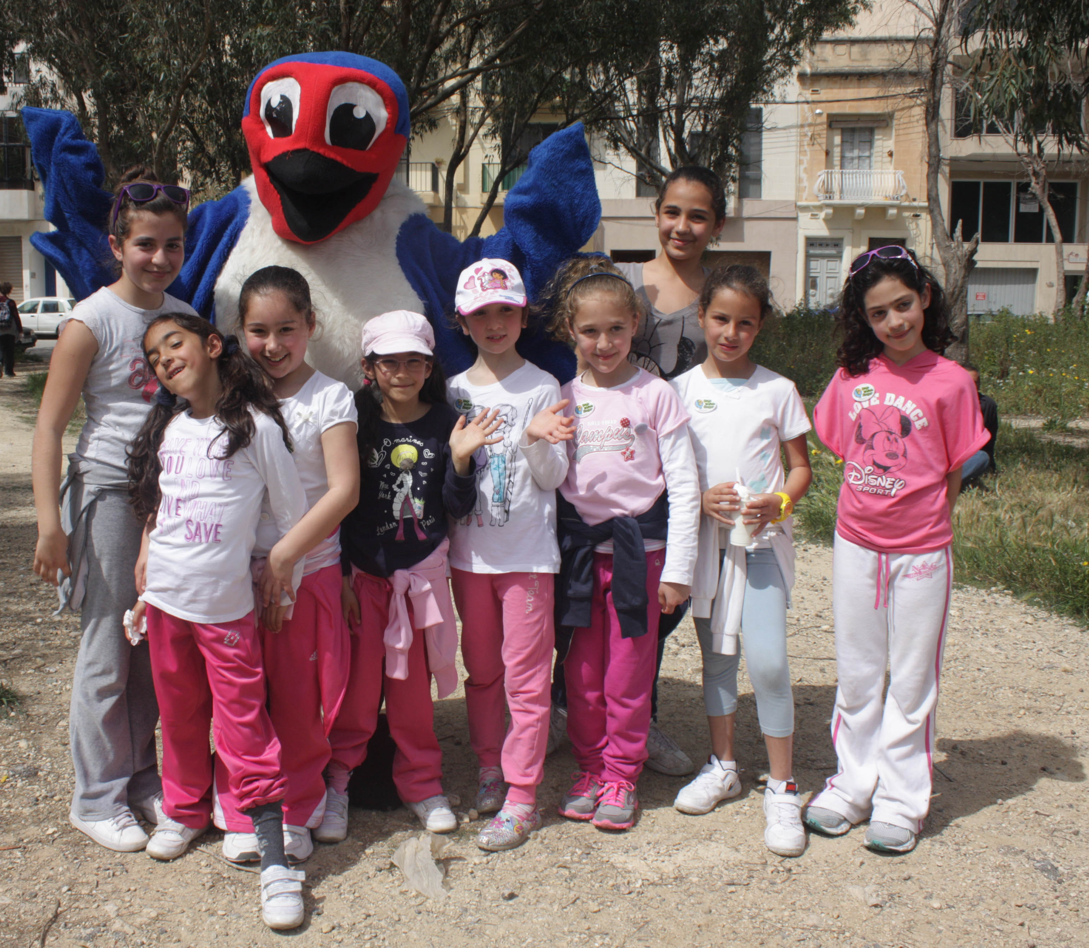

Slide 7
