Slide 1
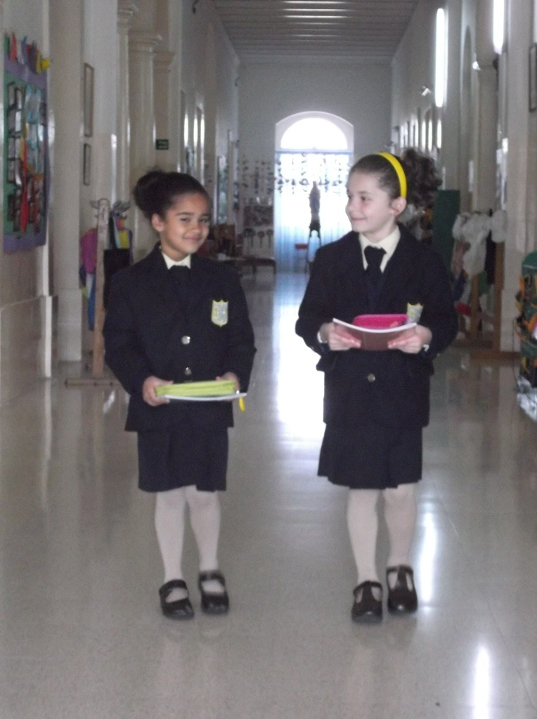
Convent of the Sacred Heart School Foundation
Junior School
Malta

Slide 2
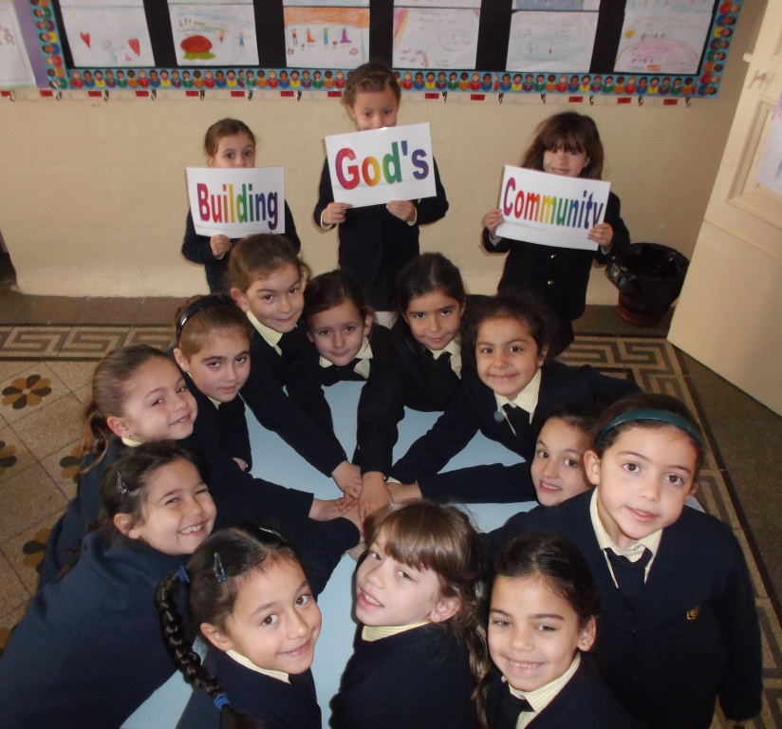
This year we are living the Goal of Community

Slide 3
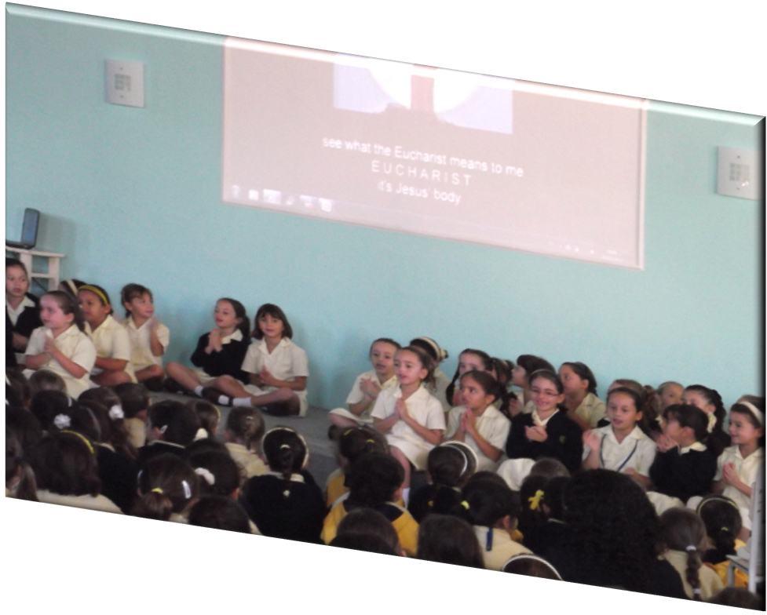
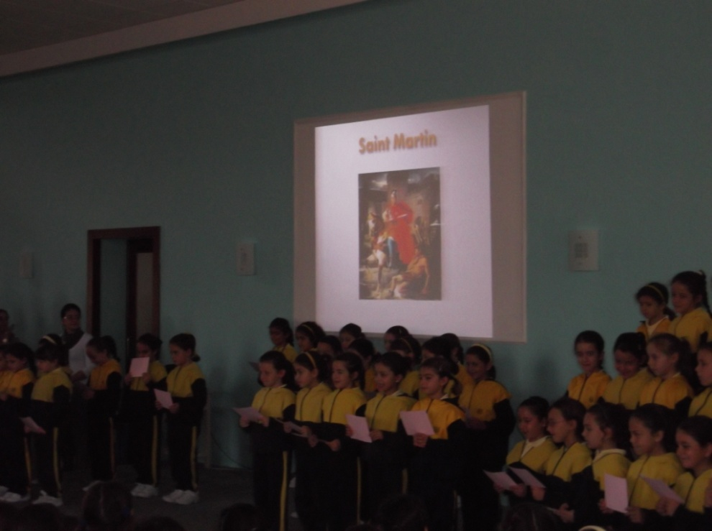
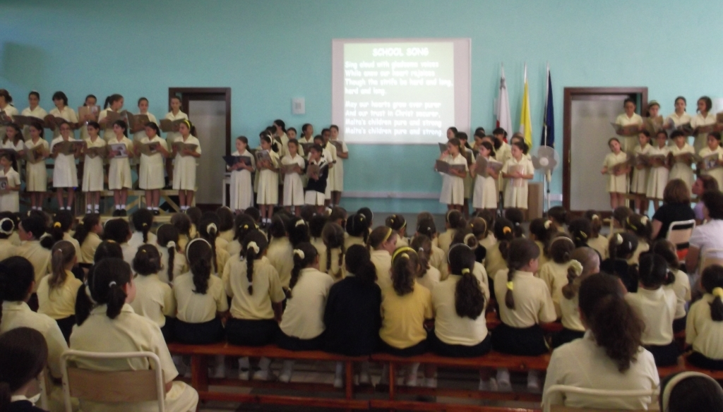
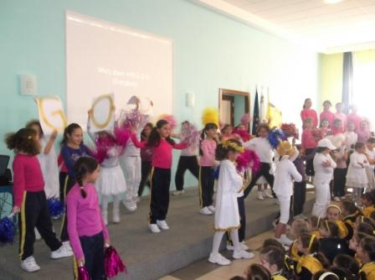
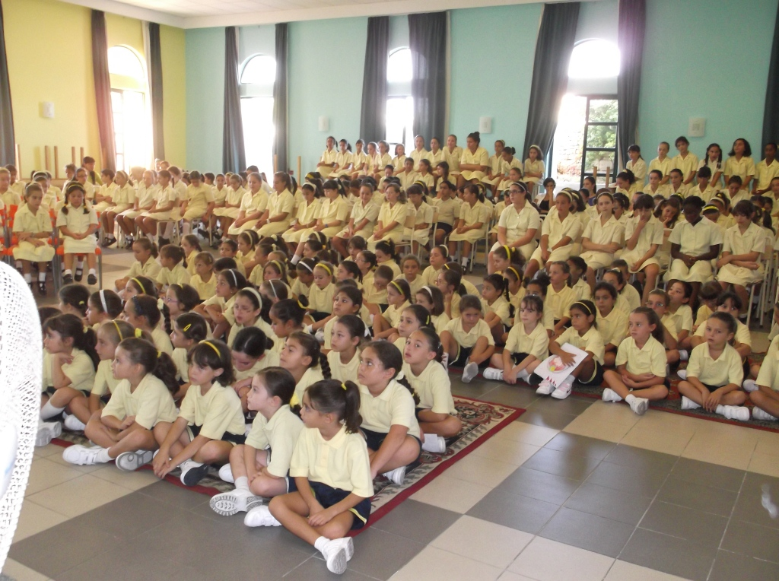
We lived the Goal of Community together….
…… in Assemblies

Slide 4
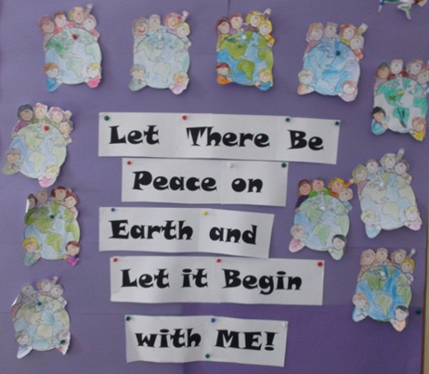
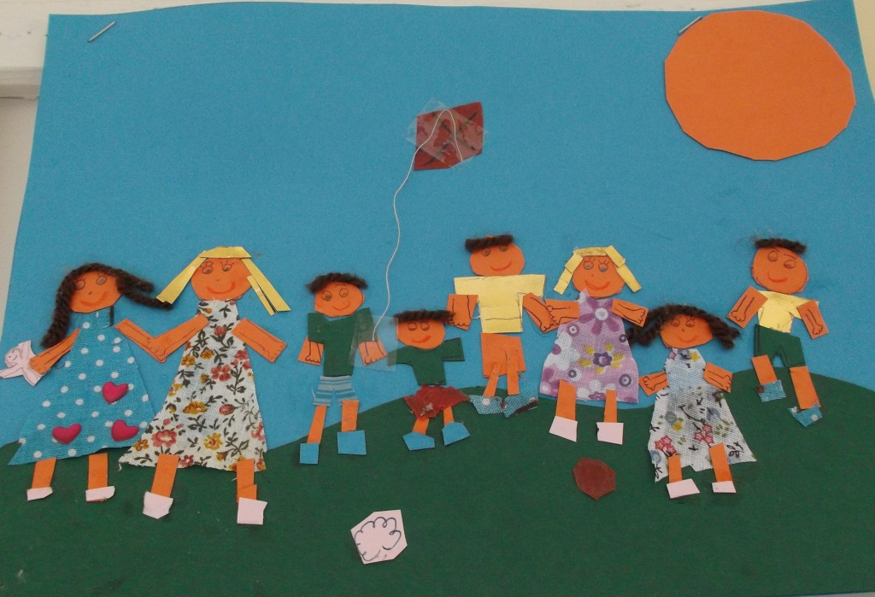
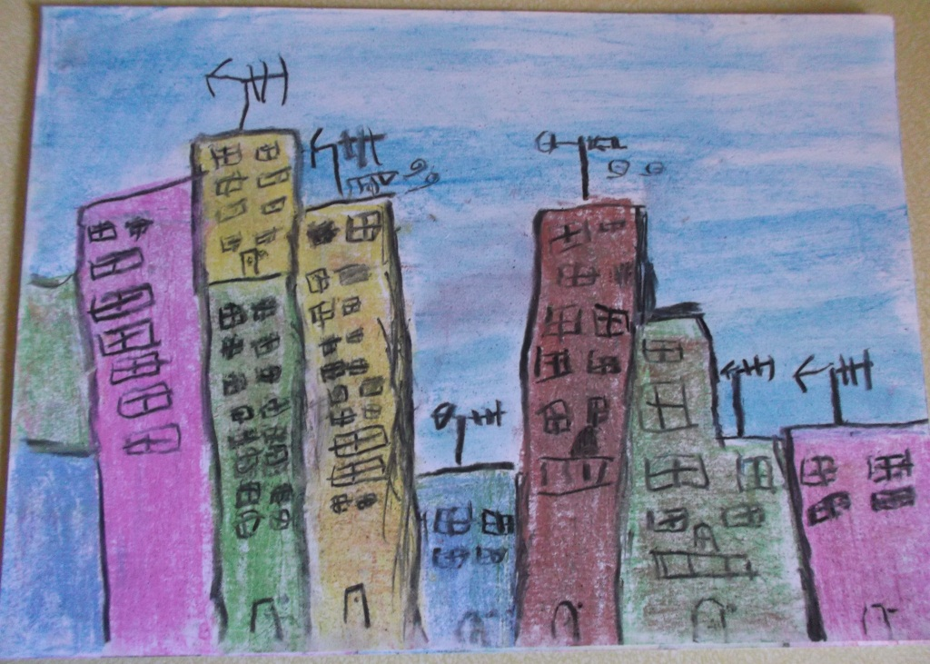
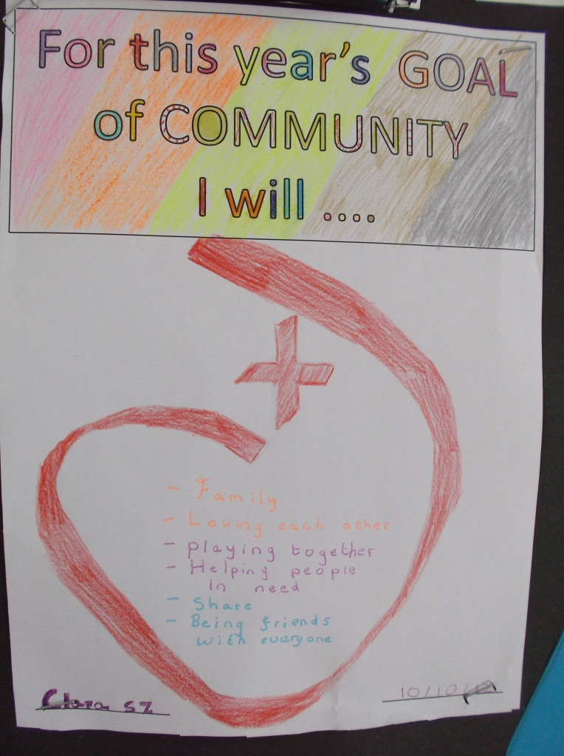
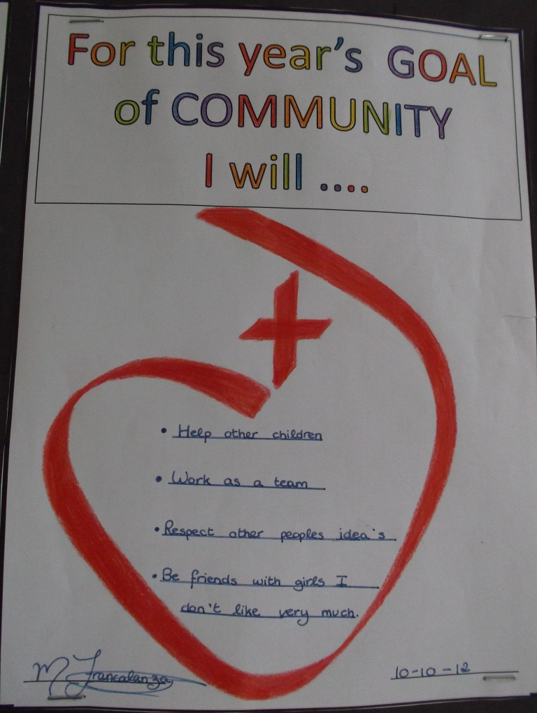
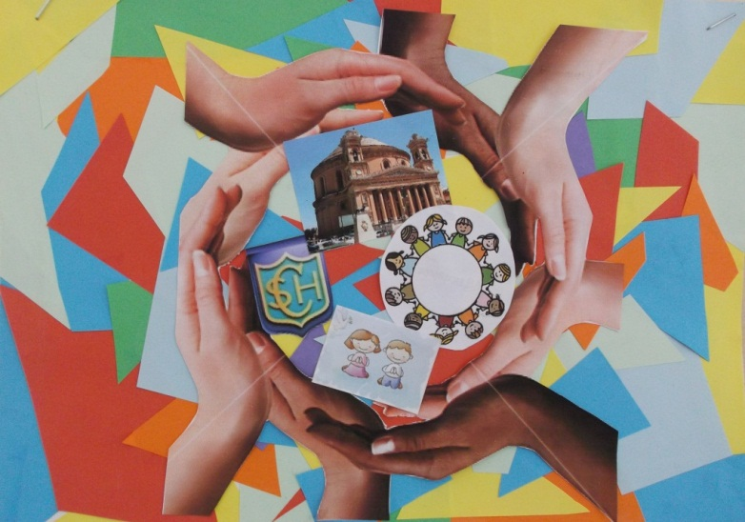
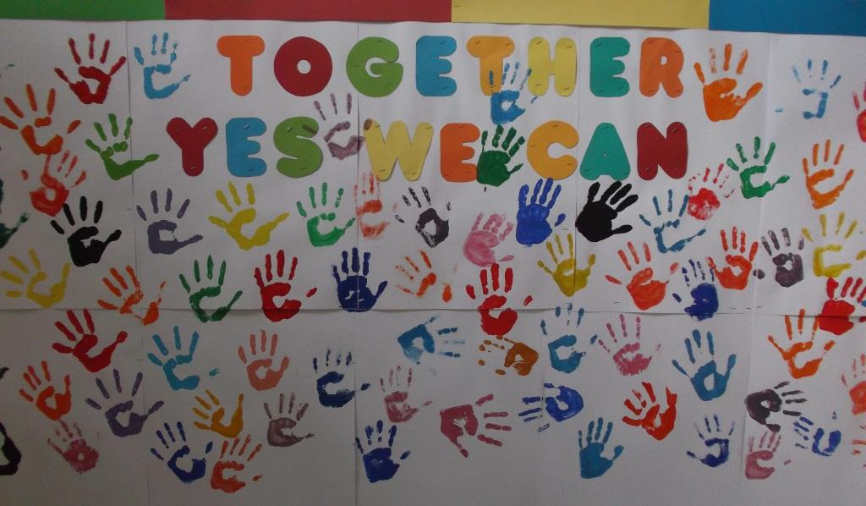
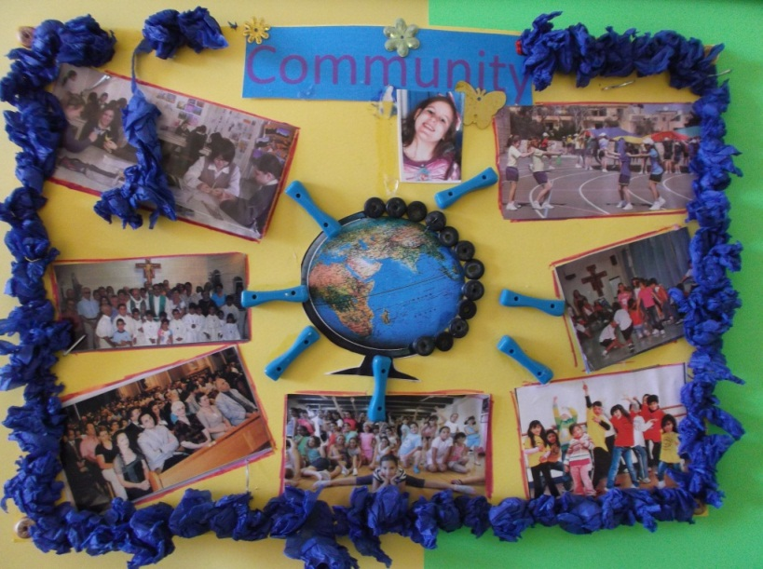
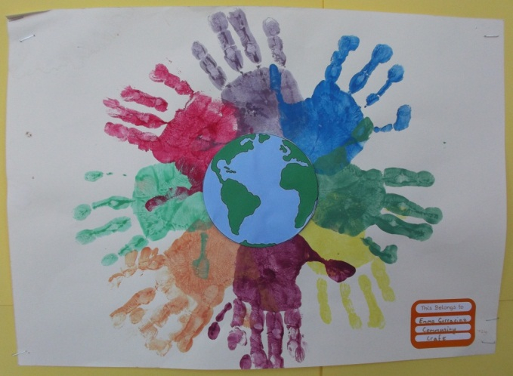
…… in Classes

Slide 5
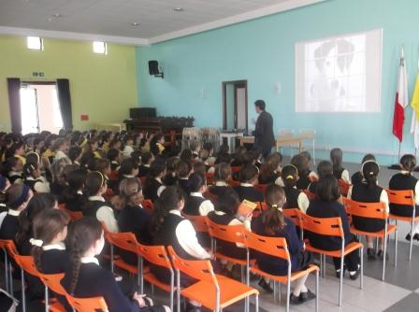
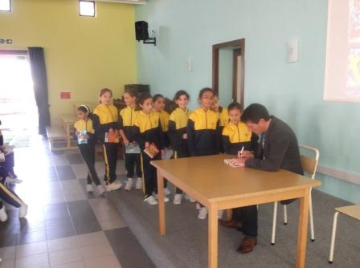
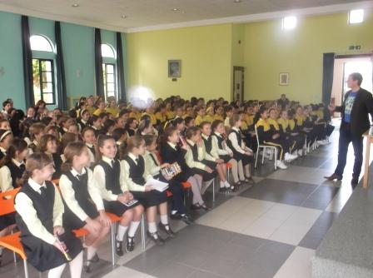
Year 5 students had the chance to meet an Author from UK

Slide 6
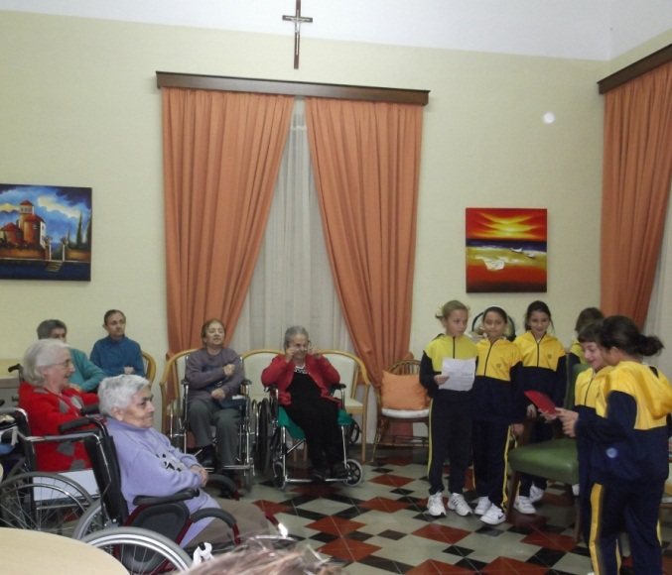
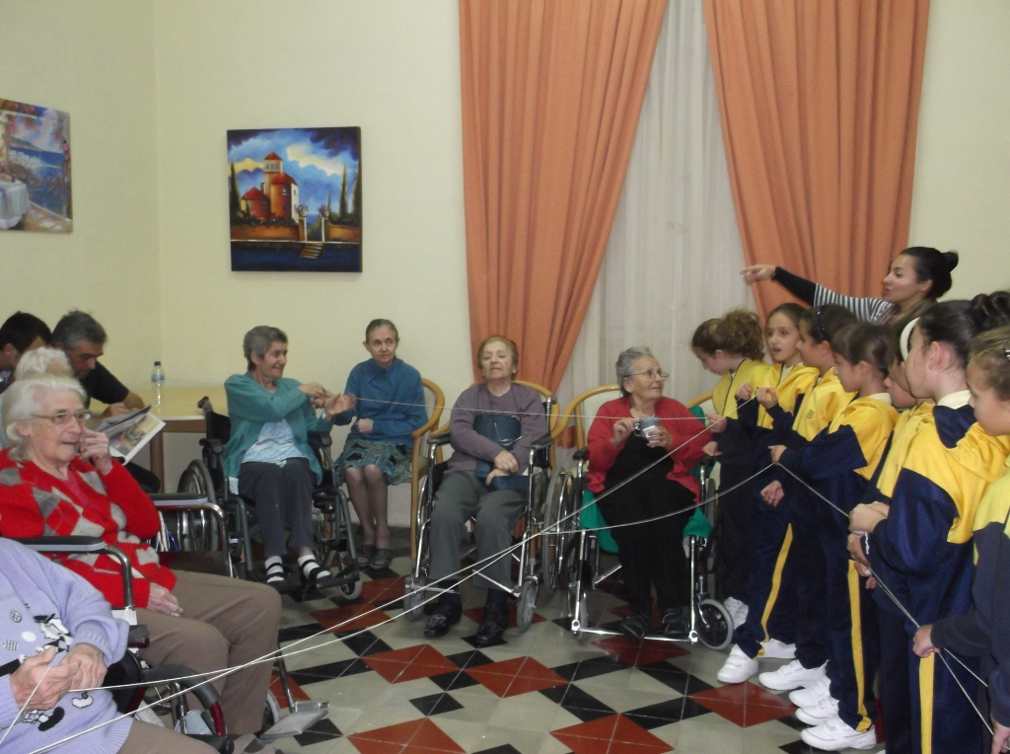
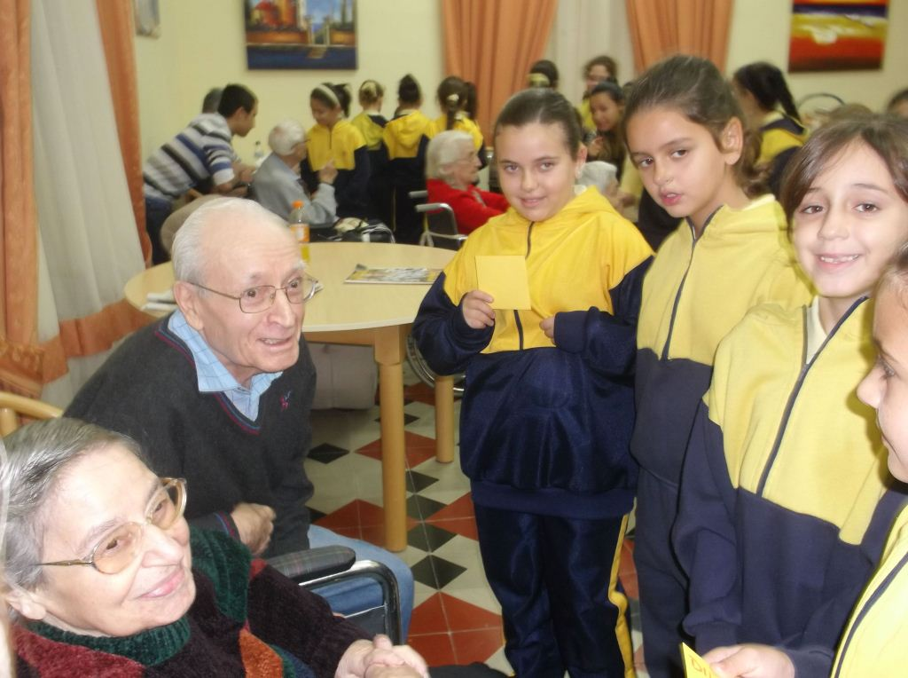
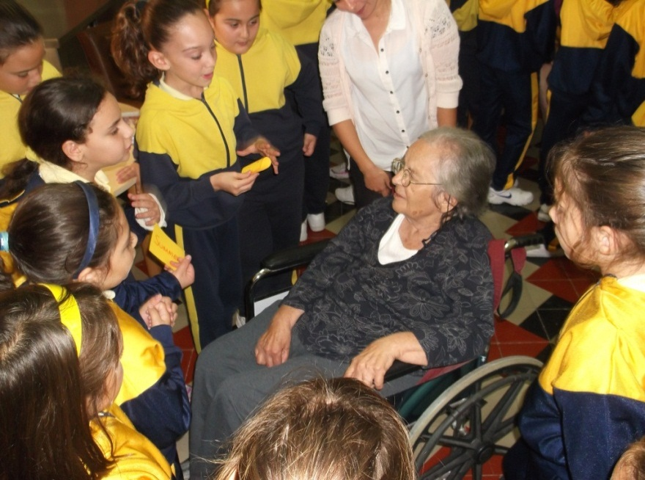
Year 5 visited the elderly at Casa Leone

Slide 7
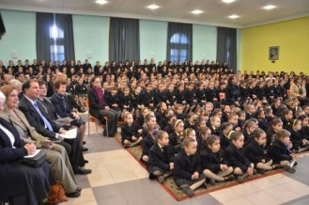
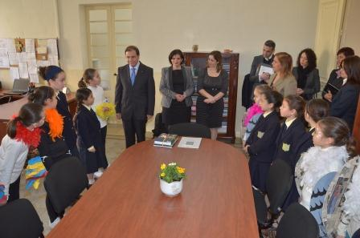
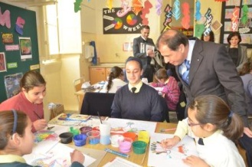
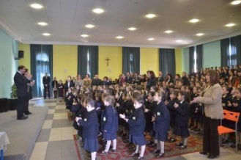
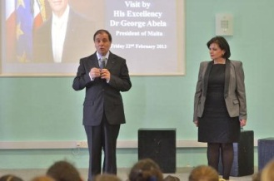
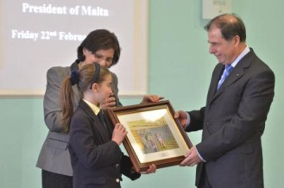
The President Visited our School on the
22nd February 2013

Slide 8
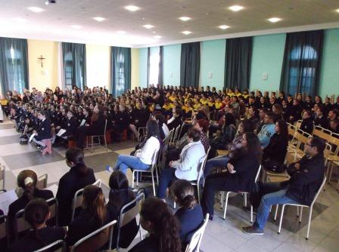
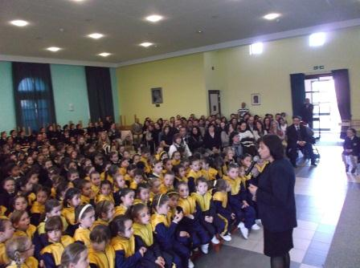
All Parents were invited to celebrate
OUR LADY OF SORROW’S MASS

Slide 9
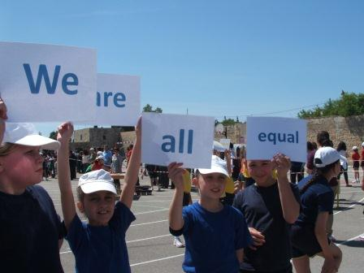
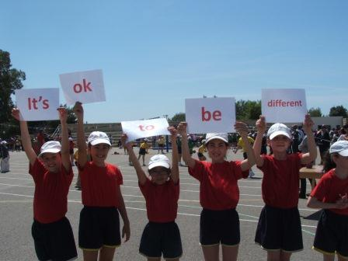
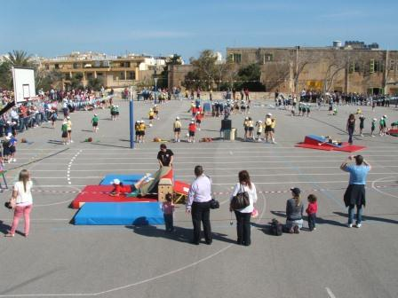
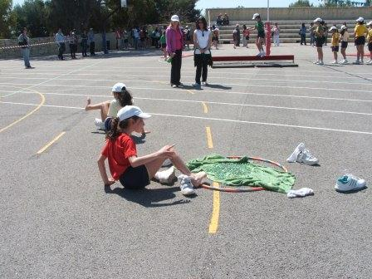
We celebrated DIVERSITY in Sports

Slide 10
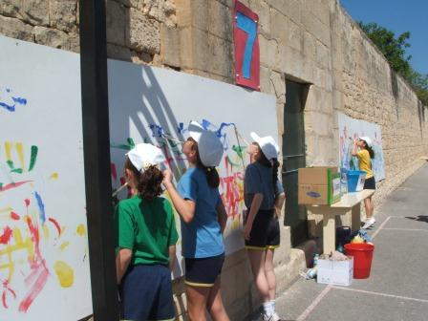
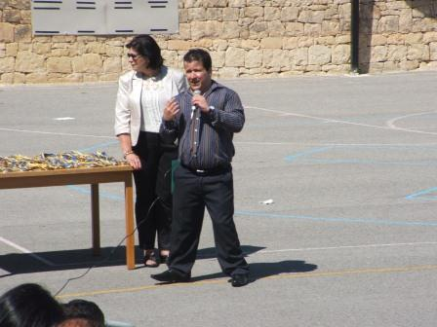
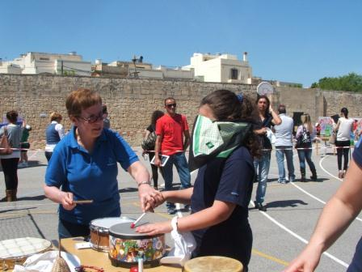

Slide 11
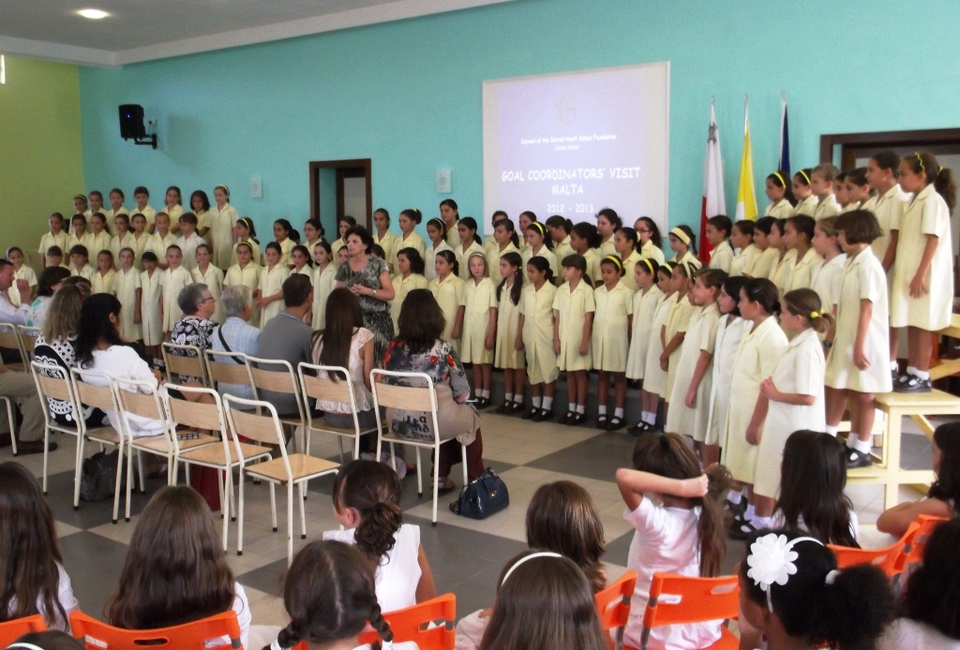
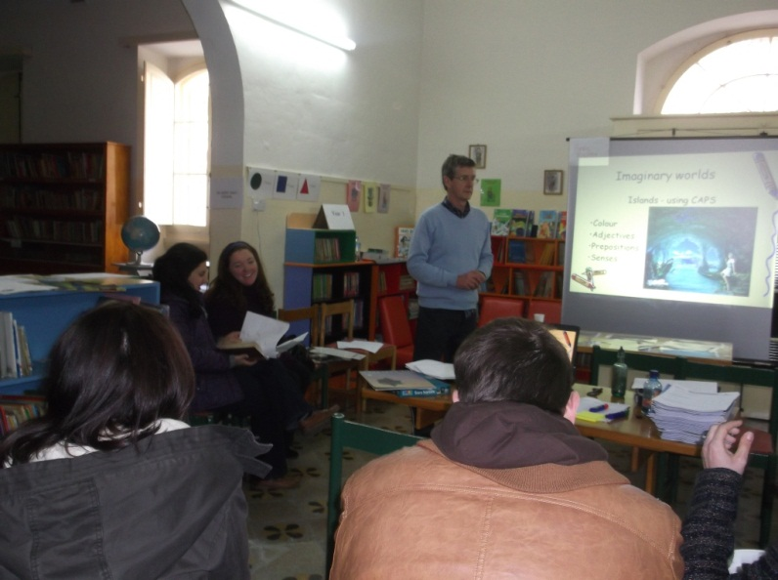
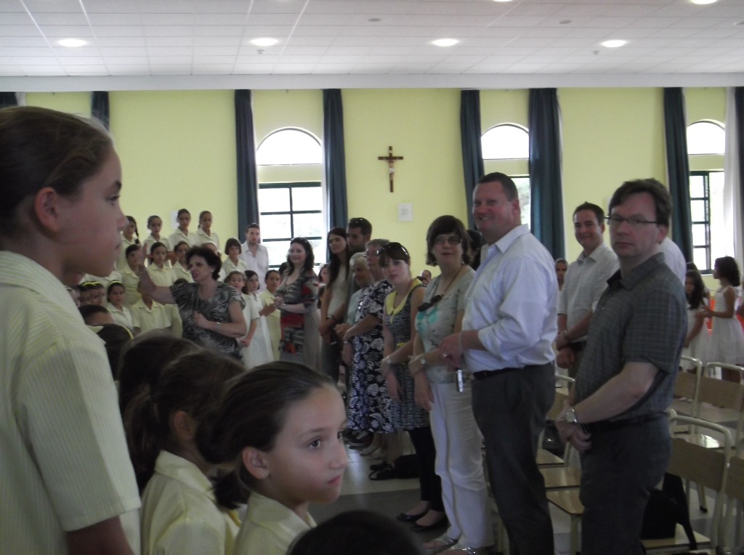
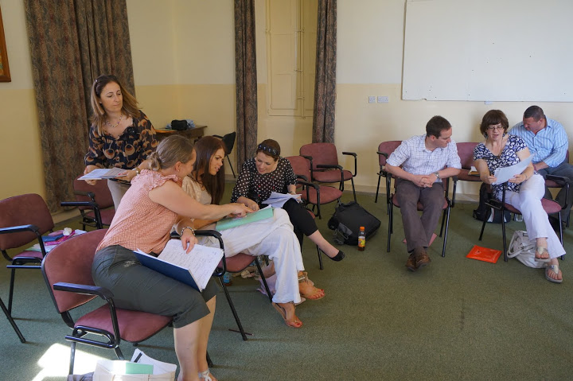
We are sharing our work with other schools in Scotland and Ireland
Lifelong
Learning
Programme

Slide 12
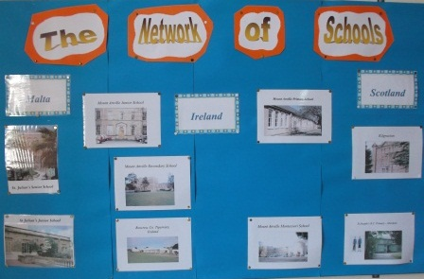
Students put up a board to show the
NETWORK OF SCHOOLS

Slide 13
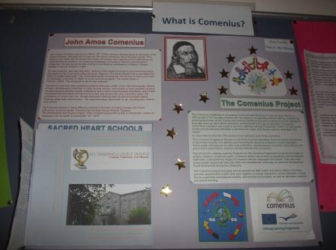
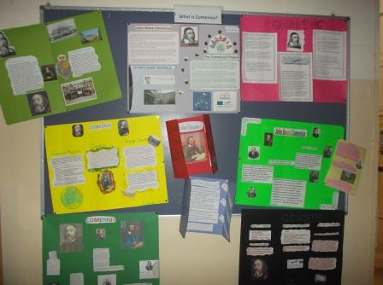
Year 6 students researched about COMENIUS
Lifelong
Learning
Programme

Slide 14
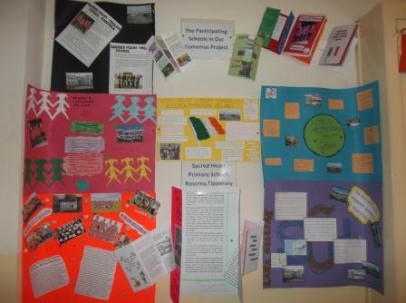
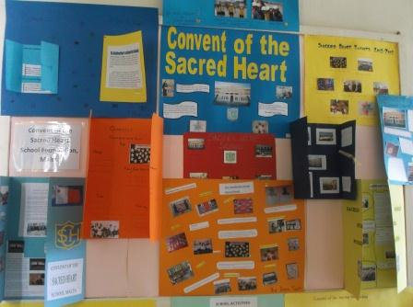
Year 5 students researched information about the Schools participating in the Project
Lifelong
Learning
Programme

Slide 15
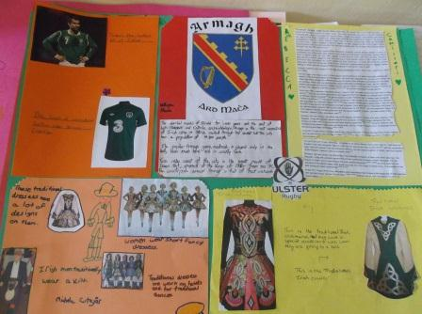
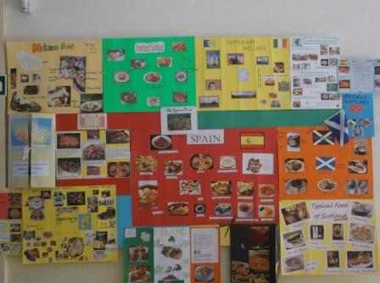
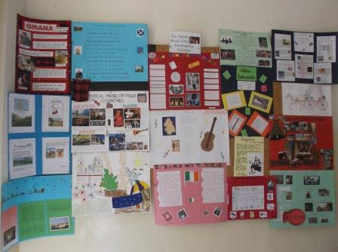
Year 4 students wrote about typical Music, Food and Costumes of the 5 participating countries
All research is being exhibited at school
Lifelong
Learning
Programme

Slide 16
Students is Year 4 have started using TWIN SPACE to communicate with each other and other children from Scotland and Ireland

Slide 17
We took part in Environmental Projects

Slide 18
Every month we helped people in need
We took part in the Piggy Bank Campaign collecting €1055.74c

Slide 19
We collected food for Kenya

Slide 20
We collected money to plant trees

Slide 21
Extra Curricular Activities with Parents and
other Volunteers

Slide 22
…… our first Crochet stitches

Slide 23
...Gardening

Slide 24
Cooking was Fun

Slide 25
....Calligraphy and Spoken English

Slide 26
...Crafts

Slide 27
....Dinja Waħda

Slide 28
...Cross-Stitch

Slide 29
......and Board Games

Slide 30
We took part in Art Competitions

Slide 31
A visit by the National Football Teams

Slide 32
Our effort was always rewarded

Slide 33
We are a COMMUNITY
We love our school
Convent of the Sacred Heart School Foundation Junior School Malta

